Slide 1
OO Design Principles
Emre Kaplan, Ph.D.

Slide 2
OO Design Principles
They are advices not laws
Obtained through experience
Knowing these principles alone does not make you a good software engineer
We’ll go through well-known principles
Source: “Principles and Patterns “ and “Agile Principles, Patterns and Practices in C#” by Robert Martin http://java-design-patterns.com/principles/#openclosed-principle

Slide 3
OO Design Principles
Generic
KISS
DRY
YAGNI
Separation of Concerns
Simplest Working Thing
Avoid Premature Optimization
Boy-Scout Rule
Source: http://java-design-patterns.com/principles/#openclosed-principle

Slide 4
Keep It Simple Stupid (KISS)
Most systems work best if they are kept simple rather than made complex.
Why
Less code takes less time to write, has less bugs, and is easier to modify.
Simplicity is the ultimate sophistication.
It seems that perfection is reached not when there is nothing left to add, but when there is nothing left to take away.
How
Avoid inheritance, polymorphism, and other complicated OOP concepts unless necessary.
Avoid low-level optimization of algorithms
Avoid large code blocks

Slide 5
DRY
DRY stands for “Do NOT Repeat Yourself”
Every piece of knowledge must have a single, unambiguous, authoritative representation within a system.
Each significant piece of functionality in a program should be implemented in just one place in the source code.
Why
Duplication (inadvertent or purposeful duplication) can lead to maintenance nightmares, poor factoring, and logical contradictions.
A modification of any single element of a system does not require a change in other logically unrelated elements.
Additionally, elements that are logically related all change predictably and uniformly, and are thus kept in sync.
How
Put business rules, long expressions, if statements, math formulas, metadata, etc. in only one place.
Where similar functions are carried out by distinct pieces of code, it is generally beneficial to combine them into one by abstracting out the varying parts.
Notes:
How
Put business rules, long expressions, if statements, math formulas, metadata, etc. in only one place.
Identify the single, definitive source of every piece of knowledge used in your system, and then use that source to generate applicable instances of that knowledge (code, documentation, tests, etc.).
Where similar functions are carried out by distinct pieces of code, it is generally beneficial to combine them into one by abstracting out the varying parts.

Slide 6
YAGNI
YAGNI stands for "you aren't gonna need it": don't implement something until it is necessary.
Why
Any work that's only used for a feature that's needed tomorrow, means losing effort from features that need to be done for the current iteration.
It leads to code bloat; the software becomes larger and more complicated.
How
Always implement things when you need them, never when you just foresee that you need them.

Slide 7
Separation of Concerns
Separating a computer program into distinct sections, such that each section addresses a separate concern.
For example, the business logic of the application is a concern and the user interface is another concern. Changing the user interface should not require changes to business logic and vice versa.
Why
Simplify development and maintenance of software applications.
When concerns are well-separated, individual sections can be reused, as well as developed and updated independently.
How
Divide and conquer
Break program functionality into separate modules that overlap as little as possible

Slide 8
Simplest Working Thing
Why
Real progress against the real problem is maximized if we just work on what the problem really is.
How
Ask yourself: "What is the simplest thing that could possibly work?“
First, implement a new capability in the simplest way you can think of that "could possibly work“
Second, and this is critical to the rule, refactor the system to be the simplest possible code including all the features it now has.
Notes:
Occam's razor (or Ockham's razor) is a principle from philosophy. Suppose there exist two explanations for an occurrence. In this case the simpler one is usually better.

Slide 9
Avoid Premature Optimization
Don’t even think about optimization unless your code is working, but slower than you want. Only then should you start thinking about optimizing, and then only with the aid of empirical data.
Understanding what is and isn’t "premature" is critical of course.
Why
It is unknown upfront where the bottlenecks will be.
After optimization, it might be harder to read and thus maintain.
How
Make It Work Make It Right Make It Fast
Don't optimize until you need to, and only after profiling you discover a bottleneck optimize that.
Donald Knuth

Slide 10
Boy-Scout Rule
"Leave the campground cleaner than you found it". The boy-scout rule states that we should always leave the code cleaner than we found it.
Why
When making changes to an existing codebase the code quality tends to degrade, accumulating technical debt.
Following the boy scout rule, we should mind the quality with each commit. Technical debt is resisted by continuous refactoring, no matter how small.
How
With each commit make sure it does not degrade the codebase quality.
Any time someone sees some code that isn't as clear as it should be, they should take the opportunity to fix it right there and then.

Slide 11
OO Design Principles
Inter-Module
Minimize Coupling
Law of Demeter
Composition over Inheritance
Robustness Principle
Inversion of Control

Slide 12
Minimize Coupling
Coupling between modules/components is their degree of mutual interdependence; lower coupling is better.
Coupling is the probability that code unit "B" will "break" after an unknown change to code unit "A".
Why
A change in one module usually forces a ripple effect of changes in other modules.
How
Eliminate, minimize, and reduce complexity of necessary relationships.
By hiding implementation details, coupling is reduced.
Apply the Law of Demeter.

Slide 13
Law of Demeter
Governs the communication structure within an object-oriented design
Principle of least knowledge → Don't talk to strangers!
Why
It usually tightens coupling
It might reveal too much implementation details
How
A method of an object may only call methods of:
The object itself.
An argument of the method.
Any object created within the method.
Any direct properties/fields of the object.
The law can be stated simply as "use only one dot".
the code a.b.Method() breaks the law where a.Method() does not.
Notes:
Code components should only communicate with their direct relations (e.g. classes that they inherit from, objects that they contain, objects passed by argument, etc.)

Slide 14
Composition over Inheritance
The “composition over inheritance” principle states that objects with complex behaviors should do so by containing instances of objects with individual behaviors rather than inheriting a class and adding new behaviors.
Class inheritance (“is-a” relationship) is a stronger form of coupling than composition (“uses-a” relationship).
A class that offers its services primarily through public class inheritance (PCI) is basically saying “to use my services you can’t just hire me; you must become me”. That’s a strong commitment!
Why
Less coupling between classes.
Using inheritance, subclasses easily make assumptions, and break LSP.
How
Test for LSP (substitutability) to decide when to inherit.
Compose when there is a "has a" (or "uses a") relationship, inherit when "is a".

Slide 15
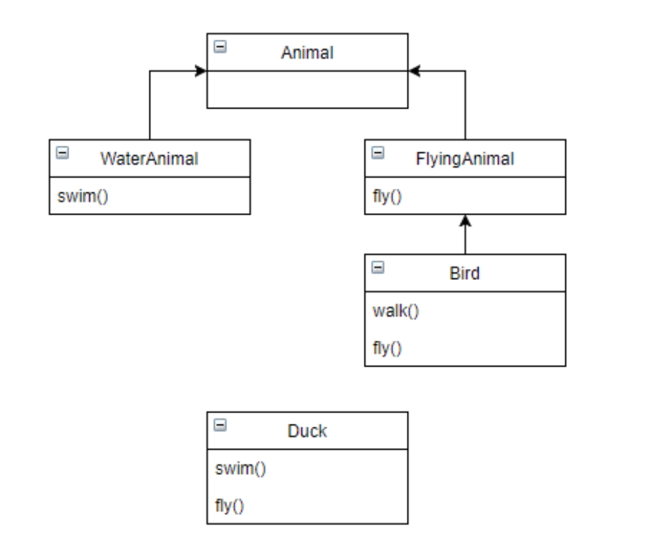
Composition over Inheritance
The inheritance hierarchy can become messy in the blink of an eye.
Less flexibility for defining special-case behaviors, particularly when you want to implement behavior from one inheritance branch in another inheritance branch.
Composition is a lot cleaner to write, easier to maintain, and allows for near-infinite flexibility as far as what kinds of behaviors you can define.
Each individual behavior is its own class, and you create complex behaviors by combining individual behaviors.

Slide 16
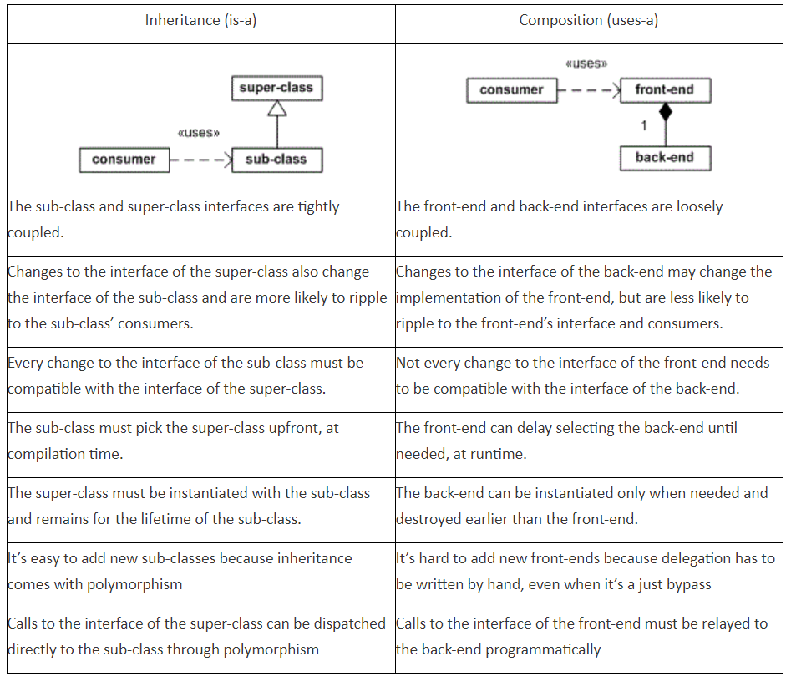
Composition over Inheritance
Source: “Favor Composition over Inheritance” https://blogs.msdn.microsoft.com/thalesc/2012/09/05/favor-composition-over-inheritance/

Slide 17
Inversion of Control (IoC)
Inversion of Control is also known as the Hollywood Principle, "Don't call us, we'll call you".
It is a design principle in which custom-written portions of a computer program receive the flow of control from a generic framework.
Inversion of control carries the strong implication that the reusable code and the problem-specific code are developed independently even though they operate together in an application.
Why
Inversion of control is used to increase modularity of the program and make it extensible.
To prevent side effects when replacing a module.
How
Using Dependency Injection
Using Factory, Strategy, Template Method patterns

Slide 18
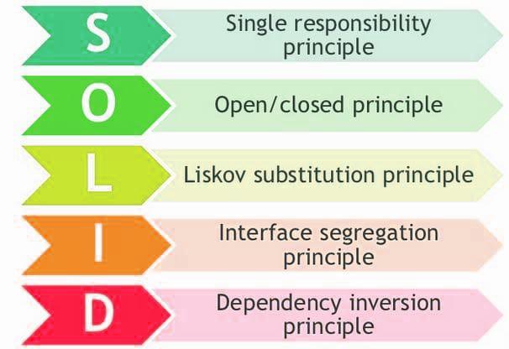
OO Design Principles
Module
SOLID
Single Responsibility Principle
Open/Closed Principle
Liskov Substitution Principle
Interface Segregation Principle
Dependency Inversion Principle
Maximize Cohesion
Hide Implementation Details
Curly’s Law
Encapsulate What Changes
Command Query Separation

Slide 19
Single-Responsibility Principle
“A class should have only one reason to change.”
A component of code (e.g. class or function) should perform a single well defined task.
Each responsibility is an axis of change. If a class assumes more than one responsibility, that class will have more than one reason to change.

Slide 20
Single-Responsibility Principle
If a class has more than one responsibility, the responsibilities become coupled.
Changes to one responsibility may impair or inhibit the class’s ability to meet the others.
This kind of coupling leads to fragile designs that break in unexpected ways when changed.

Slide 21
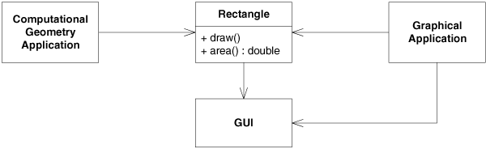
Single-Responsibility Principle
The Rectangle class has two responsibilities.
If a change to the GraphicalApplication causes the Rectangle to change for some reason, that change may force us to rebuild, retest, and redeploy the ComputationalGeometryApplication.

Slide 22
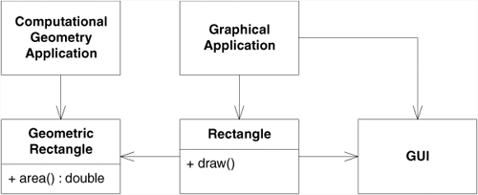
Single-Responsibility Principle

Slide 23
Open Closed Principle (OCP)
We should write our modules so that they can be extended, without requiring them to be modified.
We want to be able to change what the modules do, without changing the source code of the modules.
Software entities (classes, modules, functions, etc.) should be open for extension, but closed for modification. In other words, don't write classes that people can modify, write classes that people can extend.

Slide 24
Open Closed Principle
Why
Improve maintainability and stability by minimizing changes to existing code.
How
Write classes that can be extended (as opposed to classes that can be modified).
Expose only the moving parts that need to change, hide everything else.
Abstraction is the key of achieving OCP.

Slide 25
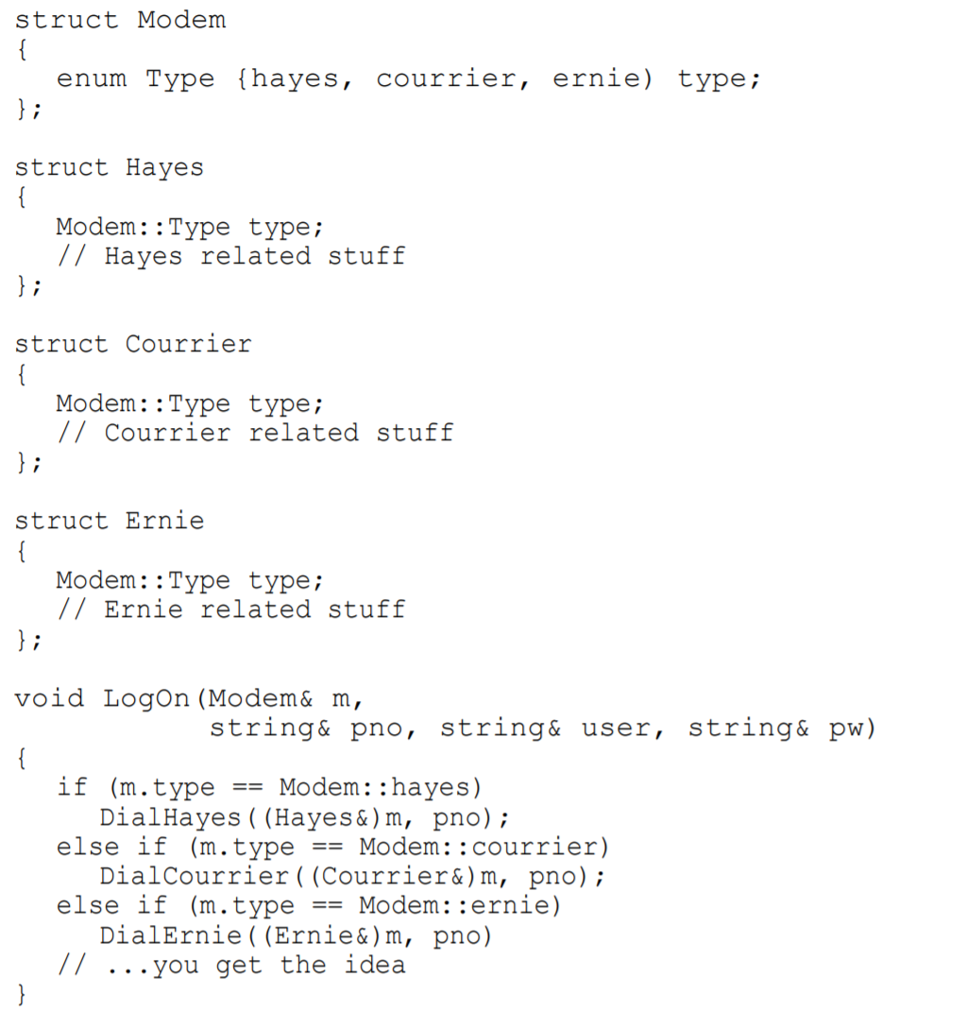
Open Closed Principle
Consider a LogOn function.
It needs to be modified upon each kind of new modem added.
Such structures make the system much harder to maintain and are very prone to error.

Slide 26
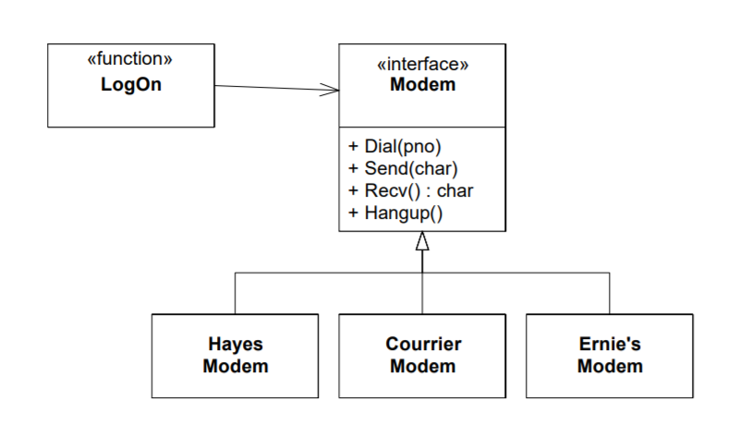
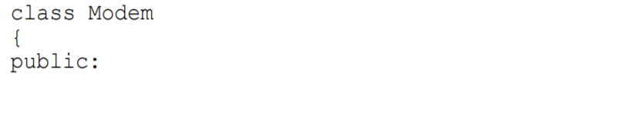
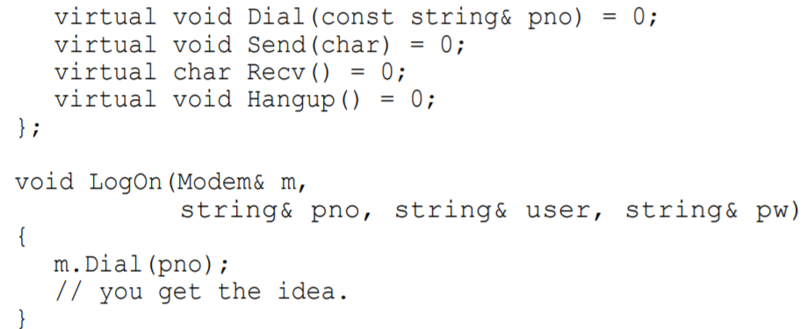
Open Closed Principle
Here the LogOn function depends only upon the Modem interface.
Additional modems will not cause the LogOn function to change.
We have created a module that can be extended, with new modems, without requiring modification.

Slide 27
Liskov Substitution Principle (LSP)
Subclasses should be substitutable for their base classes.
Objects in a program should be replaceable with instances of their subtypes without altering the correctness of that program.
A user of a base class should continue to function properly if a derivative of that base class is passed to it.

Slide 28
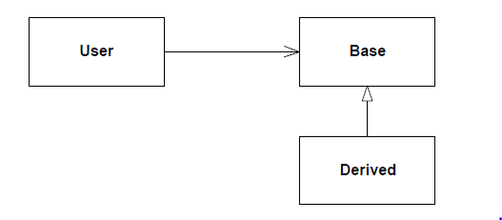
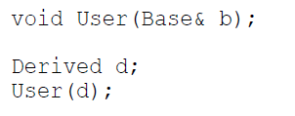
Liskov Substitution Principle
If some function User takes an argument of type Base, then as it should be legal to pass in an instance of Derived to that function.

Slide 29
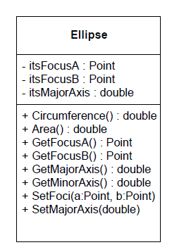
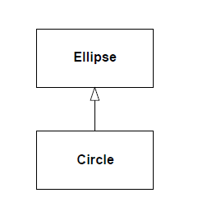
Liskov Substitution Principle
Circle-Ellipse Dilemma
All circles are ellipses with coincident foci.
Ellipse has three data elements. The first two are the foci, and the last is the length of the major axis.
If Circle inherits from Ellipse, then it will inherit these data variables.
But Circle only needs two data elements, a center point and a radius.

Slide 30
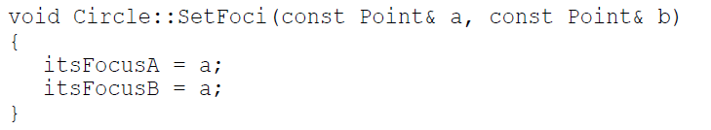
Liskov Substitution Principle
We can set both foci to same value

Slide 31
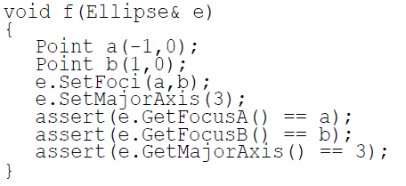
Liskov Substitution Principle
Problem arises when we expose these to public.
For example, users of Ellipse have the right to expect the code fragment to succeed:
If we pass an instance of Ellipse into this function, it will be quite happy.
However, if we pass an instance of Circle into the function, it will fail rather badly.
Clearly Circle violates LSP because it ignores the second input variable of SetFoci.

Slide 32
Liskov Substitution Principle
Design by Contract.
In order to be substitutable, the contract of the base class must be honored by the derived class.
Since Circle does not honor the implied contract of Ellipse, it is not substitutable and violates the LSP.

Slide 33
Interface Segregation Principle (ISP)
Reduce fat interfaces into multiple smaller and more specific client interfaces.
An interface should be more dependent on the code that calls it than the code that implements it.
Why
If a class implements methods that are not needed the caller needs to know about the method implementation of that class.
For example if a class implements a method but simply throws then the caller will need to know that this method shouldn't be called.
How
Avoid fat interfaces. Classes should never have to implement methods that violate the Single responsibility principle.

Slide 34
Interface Segregation Principle
Classes whose interfaces are not cohesive have “fat” interfaces.
The interfaces of the class can be broken up into groups of methods.
Each group serves a different set of clients.
The clients will only have to know about the methods that are of interest to them.
ISP is intended to keep a system decoupled and thus easier to refactor, change, and redeploy.

Slide 35
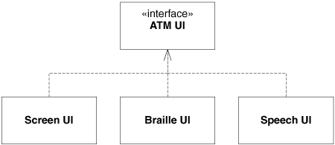
Interface Pollution
Clients should not be forced to depend on methods they do not use.
Case: ATM with multiple interfaces

Slide 36
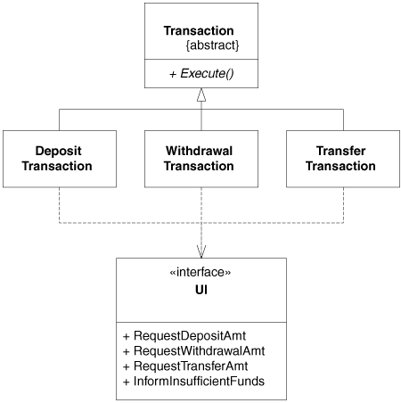
Interface Segregation Principle
Adding a new transaction changes the UI interface
All the other transactions must be recompiled

Slide 37
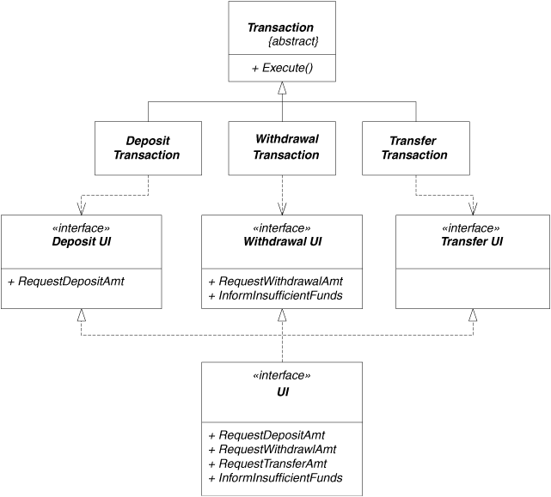
Interface Segregation Principle

Slide 38
The Dependency-Inversion Principle (DIP)
Depend upon Abstractions. Do not depend upon concretions.
The strategy of depending upon interfaces or abstract functions and classes, rather than upon concrete functions and classes.
Every dependency in the design should target an interface, or an abstract class. No dependency should target a concrete class.
DIP, is about the level of the abstraction in the messages sent from your code to the thing it is calling.

Slide 39
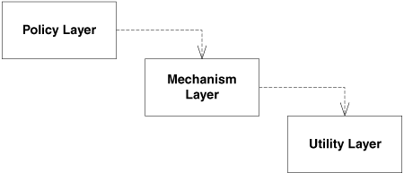
The Dependency-Inversion Principle
Naive layering scheme
High-level modules should not depend on low-level modules. Both should depend on abstractions.
Abstractions should not depend upon details. Details should depend upon abstractions.

Slide 40
The Dependency-Inversion Principle
It is the high-level, policy-setting modules that ought to be influencing the low-level detailed modules.
The modules that contain the high-level business rules should take precedence over, and be independent of, the modules that contain the implementation details.
It is high-level, policy-setting modules that we want to be able to reuse.
We are already quite good at reusing low-level modules in the form of subroutine libraries.
When high-level modules depend on low-level modules, it becomes very difficult to reuse those high-level modules in different contexts.

Slide 41
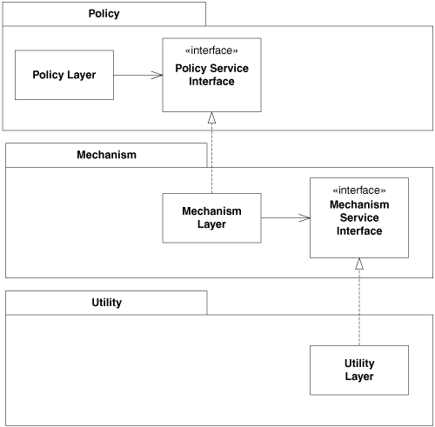
The Dependency-Inversion Principle

Slide 42

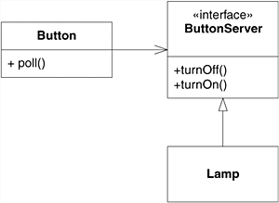
The Dependency-Inversion Principle

Slide 43
Maximize Cohesion
Cohesion of a single module/component is the degree to which its responsibilities form a meaningful unit; higher cohesion is better.
Why
Increased difficulty in understanding modules.
Increased difficulty in maintaining a system, because logical changes in the domain affect multiple modules, and because changes in one module require changes in related modules.
Increased difficulty in reusing a module because most applications won’t need the random set of operations provided by a module.
How
Group related functionalities sharing a single responsibility (e.g. in a class, module, etc.).

Slide 44
Hide Implementation Details
A software module hides information (i.e. implementation details) by providing an interface, and not leak any unnecessary information.
Why
When the implementation changes, the interface clients are using does not have to change.
How
Minimize accessibility of classes and members.
Don’t expose member data in public.
Avoid putting private implementation details into a class’s interface.
Decrease coupling to hide more implementation details.

Slide 45
Curly’s Law
Curly's Law is about choosing a single, clearly defined goal for any bit of code: Do One Thing.
A variable should mean one thing, and one thing only.
It should not mean one thing in one circumstance and carry a different value from a different domain some other time. It should not mean two things at once. It should mean One Thing and should mean it all the time.

Slide 46
Encapsulate What Changes
Encapsulate the concept that varies, i.e. a design is better when those parts that vary are encapsulated in a separate module.
A good design identifies the hotspots that are most likely to change and encapsulates them behind an API.
When an anticipated change then occurs, the modifications are kept local.
Why
To minimize required modifications when a change occurs
How
Encapsulate the concept that varies behind an API
Possibly separate the varying concept into its own module

Slide 47
Incremental Development
“Keep developing until you get it right”.
Incremental development is based on agile methodology.
Agile methods generally promote a disciplined project management process that encourages
frequent inspection and adaptation,
a leadership philosophy that encourages teamwork,
self-organization and accountability,
a set of engineering best practices that allow for rapid delivery of high-quality software,
and a business approach that aligns development with customer needs and company goals.

Slide 48
Design for Change
Anticipate new requirements and changes to existing requirements
Design for evolution
Inflexible design risks major redesign in the future
Unanticipated changes are expensive
Each design pattern ensures that a system can change in some specific ways.
[Gamma, Helm, Johnson, and Vlissides. Design Patterns. Addison-Wesley, 1994]

Slide 49
Common Causes of Redesign
Creating an object by specifying a class explicitly
create objects indirectly.
Dependence on specific operations.
avoid hard-coded requests
Dependence on hardware and software platform.
abstract out dependences
[Gamma, Helm, Johnson, and Vlissides. Design Patterns. Addison-Wesley, 1994]

Slide 50
References
OOP Concepts in Java: https://beginnersbook.com/2013/04/oops-concepts/
Design Patterns: https://www.tutorialspoint.com/design_pattern/builder_pattern.htm
Software Engineering Principles: https://www.ukessays.com/essays/it-research/software-engineering-principles.php
Design Patterns: Elements of Reusable Object-Oriented Software book by Gang of Four

